Slide 1
Of Mice & Men
By John Steinbeck
“Maybe ever’body in the whole damn world is scared of each other.”

Slide 2
Learning Objectives
Today we will learn about:
The importance of context to a novel.
The history of the Great depression.

Slide 3
The Context
It is essential when studying a novel to first study the context in which it was written.
Nobody writes in a vacuum. Every piece of literature arises from the specific cultural background that the literature was written within.

Slide 4
Facts about the Great Depression
America's "Great Depression" began with crash of the stock market on "Black Thursday", October 24, 1929
when 16 million shares of stock were sold
this meant that the price of shares collapsed. People lost all their savings
Some people committed suicide
Many people stopped buying things
Shops could not sell. Shops closed, and people lost their jobs.
By 1933, nearly 25% of the USA’s total work force, 12,830,000 people, was unemployed.
Wages fell almost 43% between 1929 and 1933.
Farm prices fell and many farmers lost their homes and land. Many went hungry.
families split up or migrated from their homes in search of work.

Slide 5
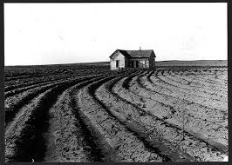
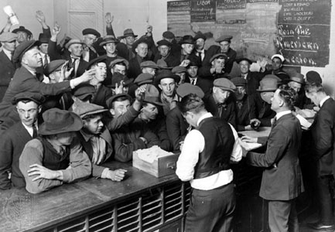
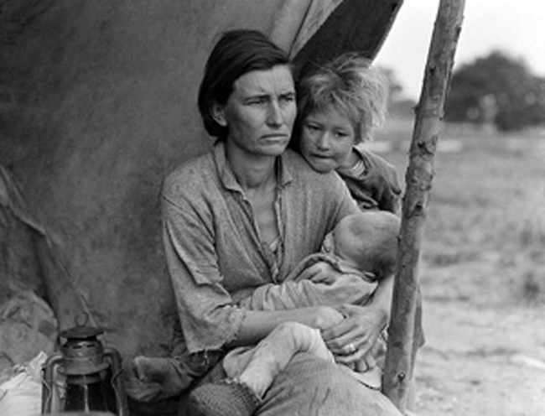
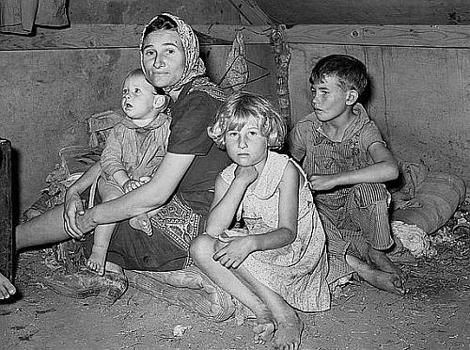
Images of the Great Depression

Slide 6
Choose 10 words to describe the way of life.

Slide 7
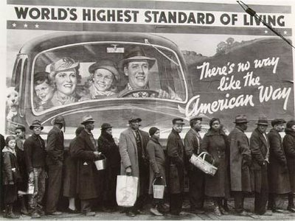
What is the message behind these images?

Slide 8
Discussion Question
In pairs what Similarities & Differences can be drawn between the Great Depression & The Recent Economic Crisis? Think about:
Jobs
Poverty
Banks

Slide 9
Learning Outcomes
Today we will learn about:
The context of the novel.
The history of the Great depression.
Migrant Workers in the 1930’s

Slide 10
Listen to the following song
Describe what life was like for people at the time.

Slide 11
Compete this Paragraph on The Great Depression
The American economy was booming in the 1920s. Then in 1929 people started to lose confidence. Many people had put all their savings in shares. They started to sell their shares. Share prices collapsed. People lost…………………………

Slide 12
Migrant Workers
What have you learnt about migrant workers?

Slide 13
Learning Objectives
Today we will learn how to:
speculate on the setting of the novel & on the characters in the novel.
Analyse the novel’s opening setting.
Analyse the narrative perspective.

Slide 14
Speculation before Reading
Setting
What do you think the setting of the novel will be like?
What will the way of life be like?

Slide 15
Character:
The Central Characters are two migrant workers:
What do you think they will look like? Why?
What types of personalities will they have? Why?
If they had dreams. What do you think those dreams would be? Why?

Slide 16
Chapter One
We will now read the first Chapter of the novel together.
Think about:
Narrative Perspective.
Setting
Character Description

Slide 17
Setting
What are the key words (adjectives & nouns) Steinbeck uses to describe setting? Why?
Draw a picture of what you think the setting looks like.
Was that an easy task? Why/ Why Not?

Slide 18
Learning Outcomes
Today we will:
Learn about the characters of the novel.
Read about the Characters.
Write the descriptions of the characters.
Draw a picture of the characters.

Slide 19
Character
How does Steinbeck create the character of George in the story?
Think about:
Physical descriptions – Adjectives, metaphor and simile.
Movement & Posture – Nouns, Verbs, simile & metaphor.
Dialogue – How does he speak? Does he have an accent? What tone does he use? What vocabulary does he use? Is it colloquial

Slide 20
How does Steinbeck create the character of Lennie in the story?
Think about:
Physical descriptions – Adjectives, metaphor and simile.
Movement & Posture – Nouns, Verbs, simile & mataphor.
Dialogue – How does he speak? Does he have an accent? What tone does he use? What vocabulary does he use? Is it colloquial

Slide 21
Draw George & Lennie

Slide 22
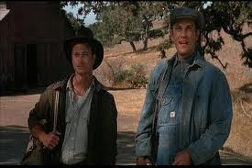
George & Lennie

Slide 23
Learning Outcomes
Today we will:
Learn about the relationship between the characters of the novel.
Read about the characters’ relationship.
Analyse their relationship.

Slide 24
Character Relationship
How would you describe the relationship between George and Lennie?
Friends?
Or is it something else? Why? Why not?

Slide 25
Learning Outcomes
Today we will:
Summarise what we learned about the characters from the text.

Slide 26
Lennie
Things they do or say: LENNIE | What this shows
Lennie rushes to drink water from the pond, without stopping to think if it is clean | He is impulsive: acts without thinking
He drinks like a horse
He copies every movement George makes
He walks behind George
He forgets things and needs to repeat them over and over. P. 21 ‘I tried not to forget.’
He likes to ‘pet soft things’
He dreams of having rabbits to look after
He tells George that if George doesn’t want him around, he can go off and live in a cave
Has killed several mice

Slide 27
George
Things they do or say: GEORGE | What this shows
Looks after the work cards | He is responsible
Warns Lennie to be careful where he drinks from
Looks after Lennie, finds work, tells him what to do
Tells Lennie not to talk when they come to the ranch
Gets angry/impatient with Lennie
Thinks about what he could do if he didn’t have Lennie with him

Slide 28
Learning Outcomes
Today we will:
Learn about P.E.E
Plan a question on character relationships.

Slide 29
How to Write A Character Question
Think About:
P.E.E
Point
Evidence
Explanation

Slide 30
Point
This is where you state your point:
Lennie is a man of immense physical strength but a childlike innocence.

Slide 31
Evidence
This is where you support the point you have made by giving evidence from the text to support your argument.
‘They was so little,’ he said apologetically. ‘I’d pet ’em, and pretty soon they bit my fingers and I pinched their heads a little and then they was dead – because they were so little.’ (p11)

Slide 32
Explanation
This is where you elaborate on your point so that you justify the argument that you are making.
Lennie clearly wants to engage with the mouse in much the same way as a child would with a pet. However his stature prohibits him from having the same integration process that he wishes to have. He cannot comprehend his own physical stature nor can he understand the damage that his size causes others; in this case a mouse.

Slide 33
Writing assignment
Describe the relationship between the characters of Lennie & George.
Think about:
P.E.E
Use at least two ‘points’ in your answer.
Remember to write an introduction & conclusion.

